Slide 1
Md. Abdul Malek Assistant Professor, Dept. of Electrical & Electronic Engineering (EEE) Rajshahi University of Engineering & Technology (RUET)

Slide 2
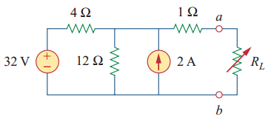
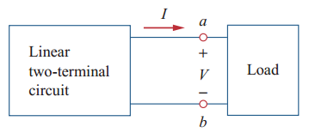
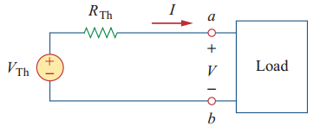
Thevenin’s Theorem
Thevenin’s theorem states that a linear two-terminal circuit can be replaced by an equivalent circuit consisting of a voltage source V_{Th} in series with a resistor R_{Th} , where V_{Th} is the open-circuit voltage at the terminals and R_{Th} is the input or equivalent resistance at the terminals when the independent sources are turned off.
Two circuits are said to be equivalent if they have the same voltage-current relation at their terminals.
Linear two-terminal circuit
Thevenin equivalent circuit

Slide 3
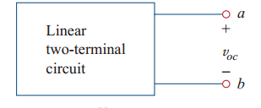
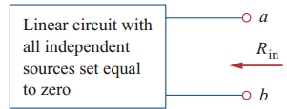
Thevenin’s Theorem

Slide 4
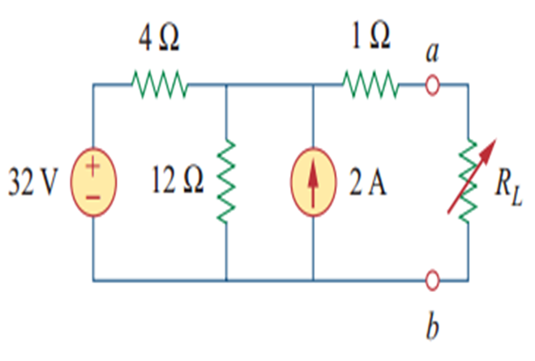
Thevenin’s Theorem
Find the Thevenin equivalent circuit of the following circuit, to the left of the terminals a-b. Then find the current through R_{L}=6, 16 and 26 Ω

Slide 5
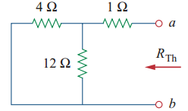


Thevenin’s Theorem
Solution: We find R_{Th} by turning off the 32-V voltage source (replacing it with a short circuit) and the 2-A current source (replacing it with an open circuit).

Slide 6
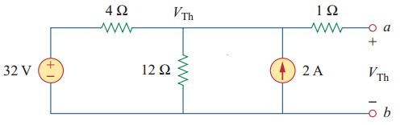
Thevenin’s Theorem
Applying nodal analysis to find V_{Th}
Applying KCL

Slide 7
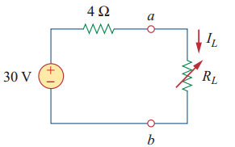
Thevenin’s Theorem
The Thevenin equivalent circuit is

Slide 8
Thevenin’s Theorem
The current through R_{L} is
When R_{L}=6Ω,
When R_{L}=16Ω,

Slide 9
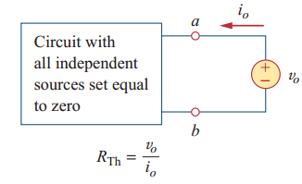
Thevenin’s Theorem
If the network has dependent sources, we turn off all independent sources. Dependent sources are not to be turned off because they are controlled by circuit variables. We apply a voltage source v_{o} at terminals a and b and determine the resulting current. Then R_{Th}= v_{o}/ i_{o} ,

Slide 10
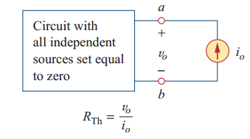
Thevenin’s Theorem
Alternatively, we may insert a current source at terminals i_{o} a-b as shown in Figure and find the terminal voltage. Again Then R_{Th}= v_{o}/ i_{o}

Slide 11
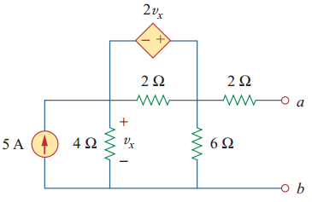
Thevenin’s Theorem
Problem: Find the Thevenin equivalent of the circuit at terminals a-b.

Slide 12
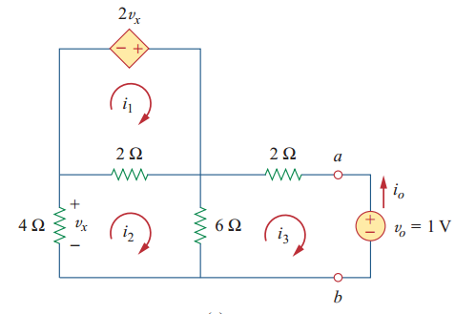
Thevenin’s Theorem
Solution: This circuit contains a dependent source. To find R_{Th}, we set the independent source equal to zero but leave the dependent source alone. we insert a voltage source v_{o} at the terminal a and b.
Applying mesh analysis to loop 1
But,
_
+

Slide 13
Thevenin’s Theorem
Applying mesh analysis to loop 2
_
_
+
+
_
+

Slide 14
Thevenin’s Theorem
Applying mesh analysis to loop 3
_
+
_
+

Slide 15
Thevenin’s Theorem
After solving equation (i), (ii) and (iii), we get,
But,

Slide 16
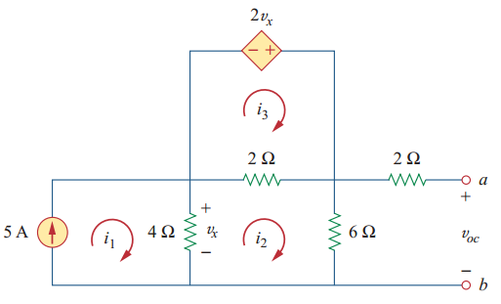
Thevenin’s Theorem
To get V_{Th}, we find v_{oc} in the circuit,
From loop 1, we can find

Slide 17
Thevenin’s Theorem
Applying mesh analysis to loop 2
_
_
+
+
+
_

Slide 18
Thevenin’s Theorem
Applying mesh analysis to loop 3
_
+
But

Slide 19
Thevenin’s Theorem
After solving equation (i), and (ii), we get,
Hence,

Slide 20
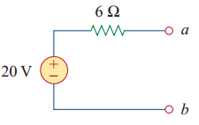
Thevenin’s Theorem
The Thevenin equivalent circuit is

Slide 21
Thank You

